Slide 1
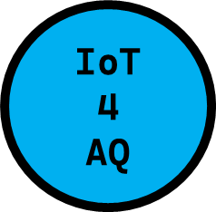


HOW YOU CAN BUILD YOUR OWN AIR QUALITY MONITOR STEP BY STEP
DEMO N° 3
ESP32/Wi-Fi module/PMS5003
Dr. Jacob Mb. Taamté,
Research Centre for Nuclear Science and Technology, P.O. Box 4110 Yaoundé, Cameroon

Slide 2
Here are the steps to follow…
Here is how to proceed:
Purchase your electronic components and modules (sensors, programmable cards and accessories...).
Test of each electronic component and carry out the configuration test for each sensor using the CPU.
Connect the components with wires as shown on the block diagram.
Choose an API platform (Here Thingspeak).
Code and programme your block system (write the general operating code of the system using a software - use Arduino IDE, Python, Visual studio code or MicroPython…).
Power the block system and test it (check the data on the LCD screen and on Thingspeak).
If the system works, then perform a calibration of different sensors (use standard or reference grade instruments).

Slide 3
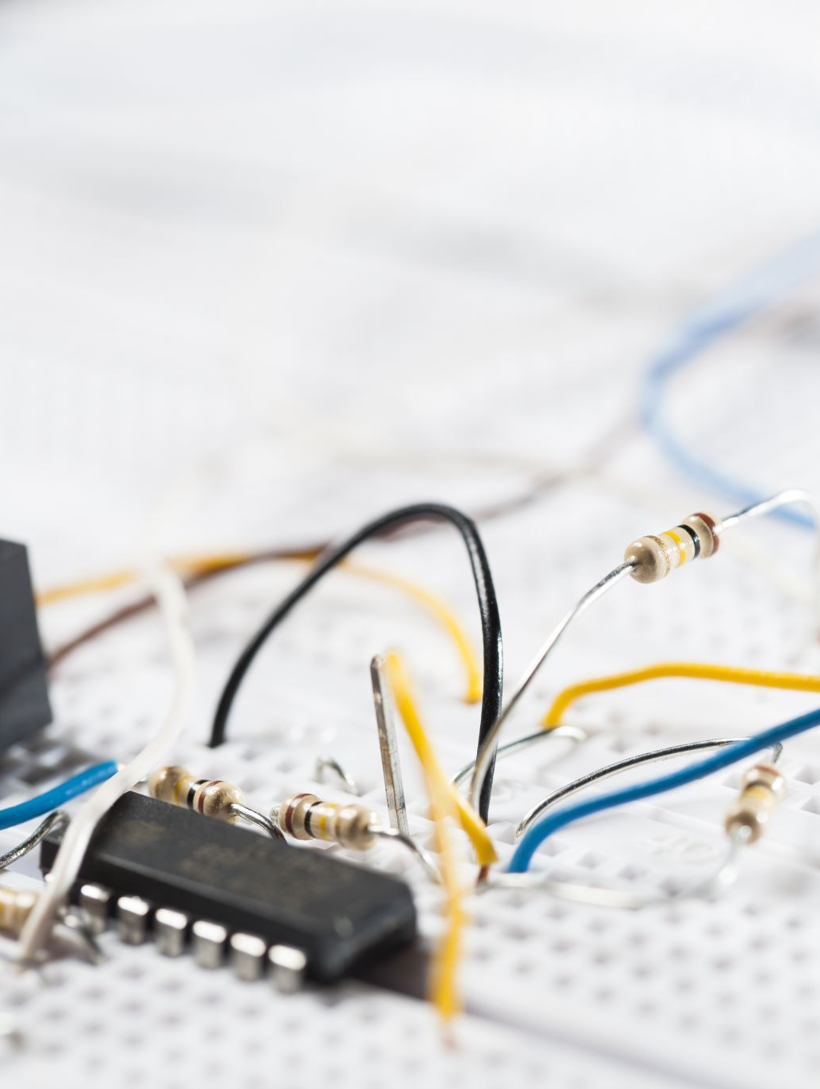
1. BUY THE COMPONENTS

Slide 4
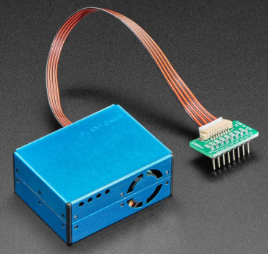
1. The dust sensor PMS5003
PMS5003 Characteristics :
Monitor air pollution cheaply and accurately with this Plantower PMS5003 particulate matter (PM) sensor !
It is a laser dust sensor which uses the principle of laser light scattering to measure the value of dust particles of different sizes (PM1, PM2.5, PM10) suspended in the air.
Specifications
Measuring range : 0.3~1.0；1.0~2.5；2.5~10 μ m;
Effective range : 0~500 μ g/m³;
Maximum range : * ≥1000 μ g/m³;
Resolution : 1 μ g/m³;
Standard volume : 0.1L;
Power supply DC : Typ:5.0 / Min:4.5 / Max : 5.5V;
Active current : ≤100 mA;
Standby current : ≤200 μ A;
Weight (cable and adapter included) : 42.2g.

Slide 5
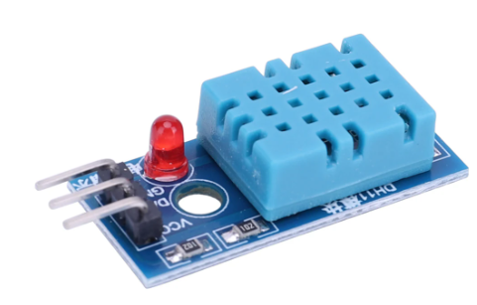
2. The temperature and humidity sensor DHT-11
Description
The DHT11 sensor consists of a temperature sensor based on NTC (Negative Temperature Coefficient) and a resistive humidity sensor. The sensor is factory calibrated and its calibration parameters are stored in the OTP (One Time Programmable) memory of the microcontroller. It has three usable pins : VCC, GND and Data.
Technical characteristics :
+5V supply (3.5-5.5V),
Consumption: 0.5 mA / 2.5 mA;
Temperature: from 0 to 50°C (accuracy: +/-2°C)
Humidity: from 20 to 96% RH (precision: +/-5%)

Slide 6
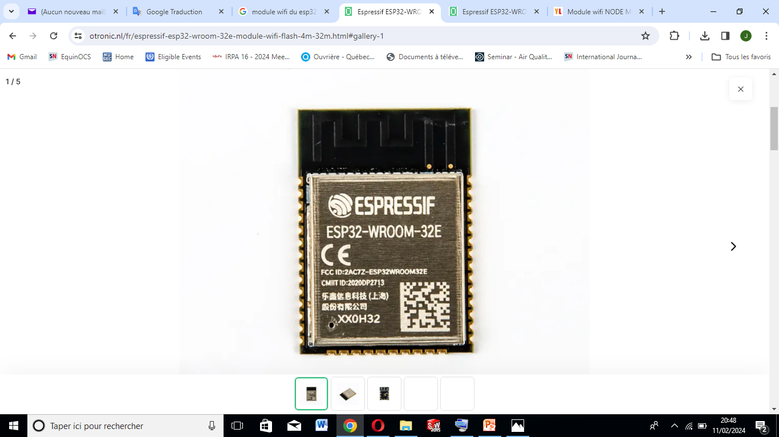
3. The ESP32-WROOM-32E IoT connection module
Description
Espressif's ESP32-WROOM-32E is a complete module that integrates Bluetooth, Bluetooth LE and Wi-Fi. This powerful and generic Wi-Fi+BT+BLE MCU module can be used for a wide range of applications. This module features an ESP32-D0WDQ6 chip designed to be scalable and easily adaptable. With 2 processor cores that can be controlled independently and a processor clock frequency that can be adjusted from 80 MHz to 240 MHz.
Technical characteristics :
Supply voltage 3~3.6V DC
19.5dBm power transmitter
Receiver sensitivity -97dBm
SMD mounting
Dimensions 18x19.2x3. 2mm
Bandwidth 2412...2484 GHz
Flash memory capacity 16Mb

Slide 7
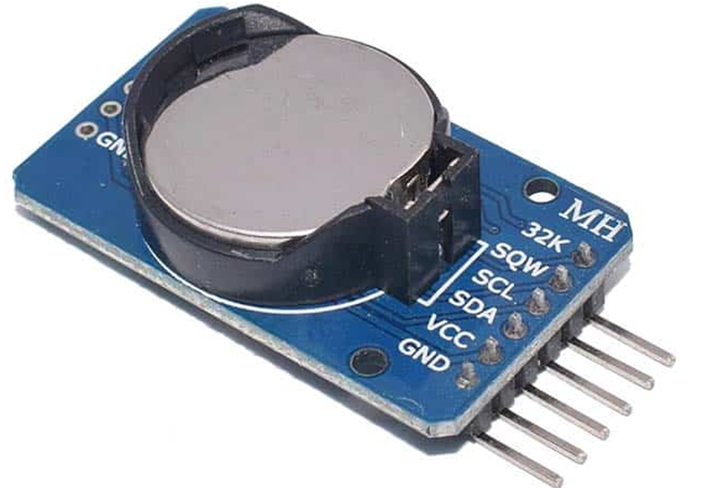
4. The DS3231 RTC module
Description
The Real Time Clock (RTC) is an electronic module capable of restoring the seconds, minutes, hours, date, month and year, the clock manages the hours in 12/24 hour format as well as the indication "AM/PM ".
Technical characteristics :
Power supply: 3 to 5 Vdc
Accuracy: ±2ppm
2 alarms
I2C output (400KHz max.)
Low consumption
Calendar until 2100
Slot for CR1220 backup battery (to be provided)
Dimensions: 22.8 x 17.8mm

Slide 8
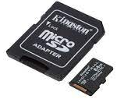
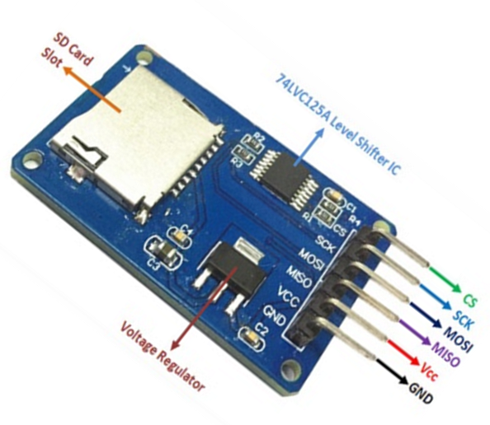
5. The microSD module
Description
The microSD card allows you to store the data of your projects, it has all the pins: SD SPI: MOSI, SCK, MISO and CS with the possibility of reading and writing on the SD card using an ESP32 card.
Technical characteristics :
Supports Micro SD cards, Micro SDHC card (high speed card);
Level conversion interfaces for 5 V or 3.3 V;
Power supply is 4.5V~5.5V, 3.3V voltage regulator circuit board;
Communication standard SPI interface;
4 M2 screw locating holes for easy installation.

Slide 9
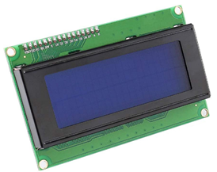
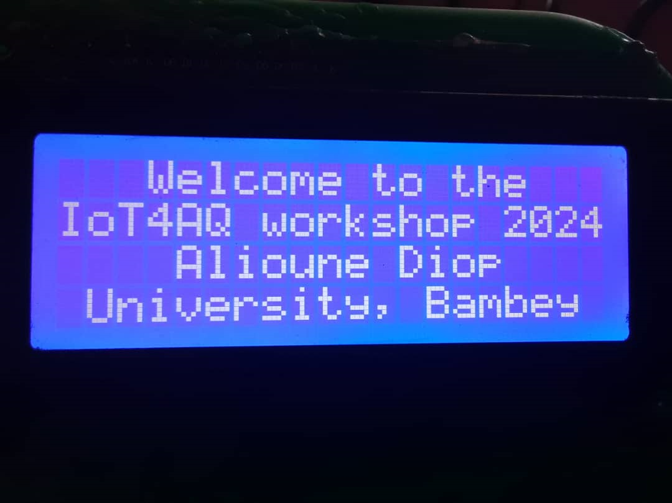
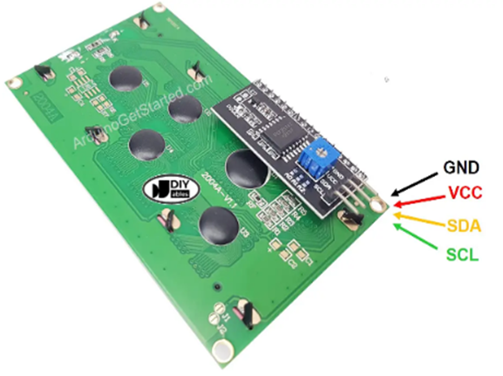
6. The LCD screen
Description
The 20x4 LCD screen is a screen that can display 4 lines with 20 characters per line (simultaneously). The color of the characters is white and the screen has a blue background. The contrast is adjustable thanks to the pre-soldered I2C module. The screen can connect to an Arduino, Raspberry Pi, ESP32, ESP8266, etc. It has 4 pins: GND, VCC, SDA, SCL.
Technical characteristics :
Interface: I2C, I2C address: 0x20
Software version: 0022
SDA (DATA) -> analog input pin 4
SCL (CLOCK) -> analog input pin 5
Pin Definition: GND.VCC.SDA.SCL
Backlight (blue with white color)
Supply voltage: 5V
PCB size: 60mm*99mm

Slide 10
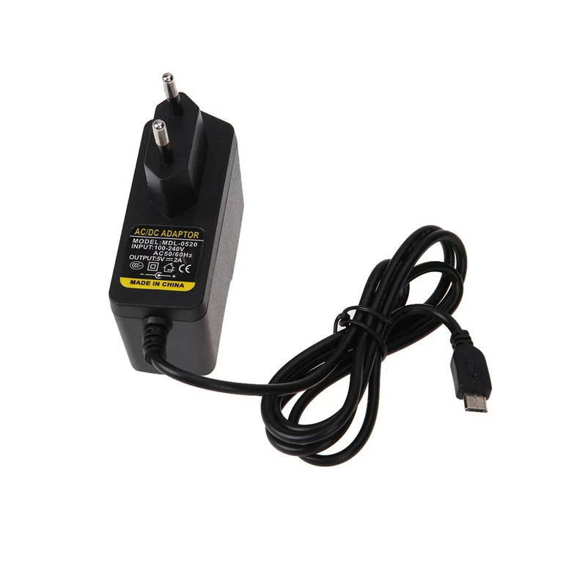
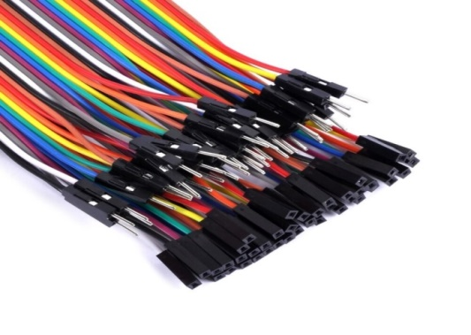
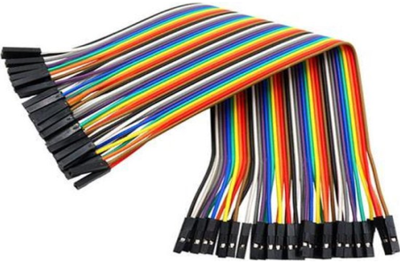
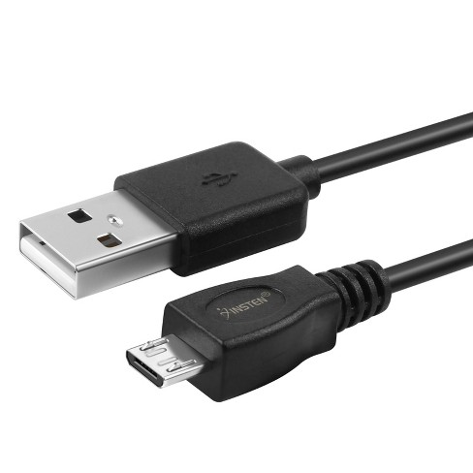
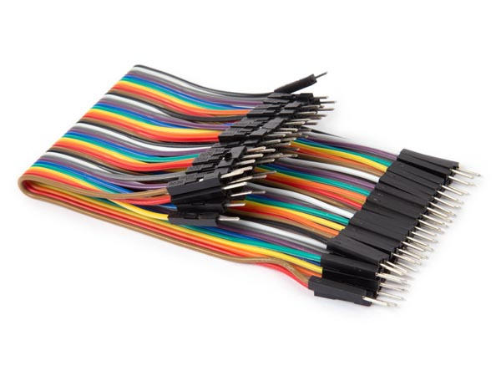
7. The cables
Description
The connection cables or jumpers of 20 cm each. These include male-to-male, female-to-male and female-to-female connection cables.
EU AC to DC 5V 2A Micro USB Power Supply Adapter for Windows Android Tablet
Female-to-male
Female-to-female
Male-to-male
USB Android cable

Slide 11
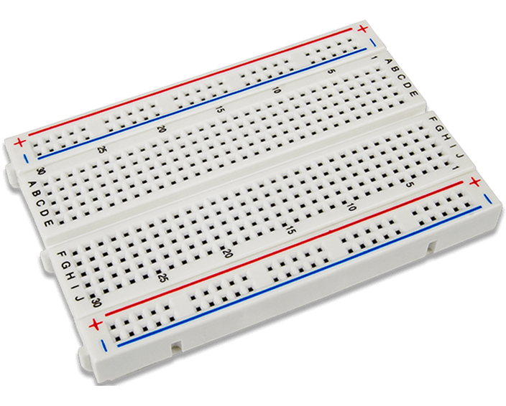
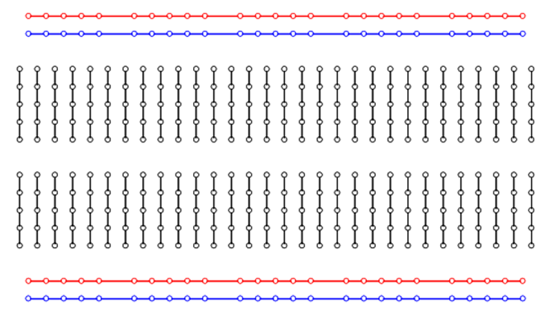
8. The breadboard
Description
The breadboard is a very practical tool that allows scientists and technicians to carry out tests and experiments. It is made up of a flat surface and a fixing system that keeps samples and instruments in place.
Internal connections
All the points of the same power bus line (in red and black in the diagram) are connected to each other.
All the points of a half-column are connected to each other (in blue on the diagram).
The columns are cut in two by the central rail which makes it possible to put components "astride"

Slide 12
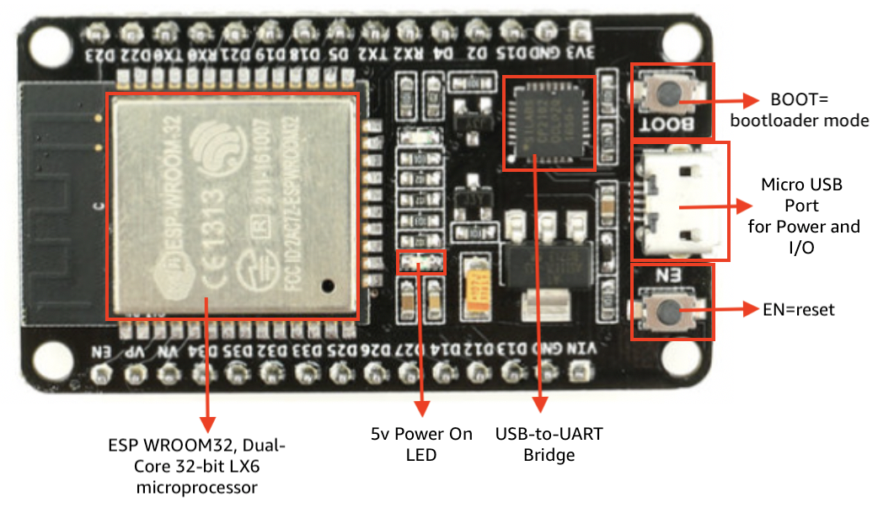
9. The ESP32 board

Slide 13
9. The ESP32 board
Description
ESP32 is a series of system-on-a-chip (SoC) type microcontrollers from Espressif Systems. The module is clocked at 240 MHz integrates a colorful collection of peripherals ranging from capacitive touch sensors, Hall sensors, SD card interface, Ethernet, high-speed SPI, I2S and I2C UART. This board is programmed via the Arduino IDE and is compatible with LUA scripts. It has WiFi and Bluetooth interfaces ideal for connected objects.
Characteristics:
Power supply: 5 Vdc via micro-USB, 3.3 VDC via Vin pins;
Microcontroller: ESP32;
Microprocessor: Tensilica LX6 Dual-Core;
Frequency: 240MHz, SRAM memory: 512 kB, Flash memory: 4 Mb;
Interfaces: I2C, SPI, 2x UART;
I/O available: 15 digital I/O including 10 PWM compatible, 2 x analog outputs (DAC), 15 x analog inputs (ADC);
Operating temperature: -40 to 125°C, Dimensions: 48 x 26 x 11.5mm;
ESP32-S wifi module.

Slide 14
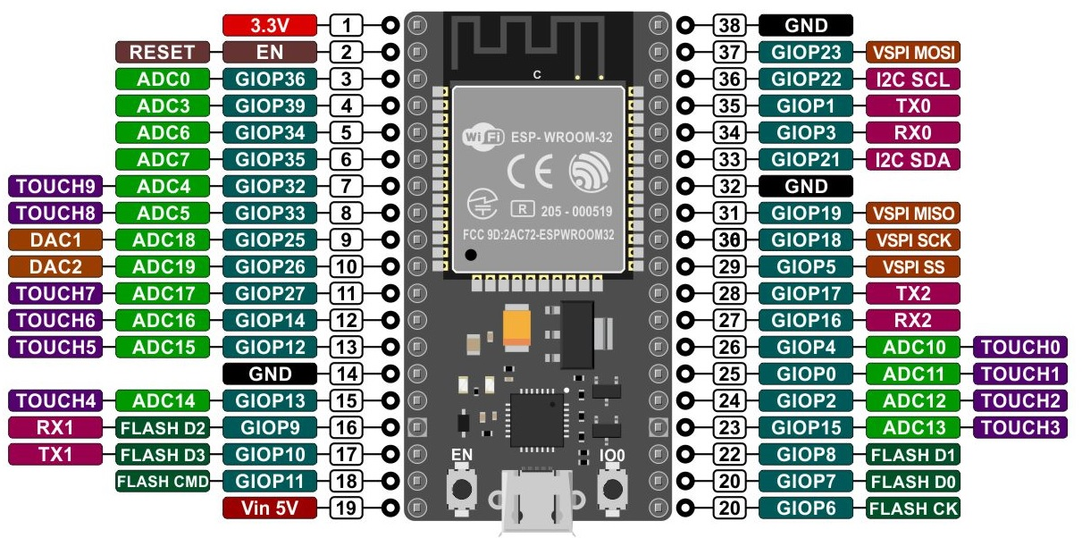
9. The ESP32 board

Slide 15
10. The marketplace
https://aliexpress.com
https://alibaba.com
Components can be found in electronic shops in your city or you can order them from dedicated websites!

Slide 16
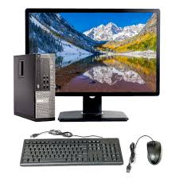
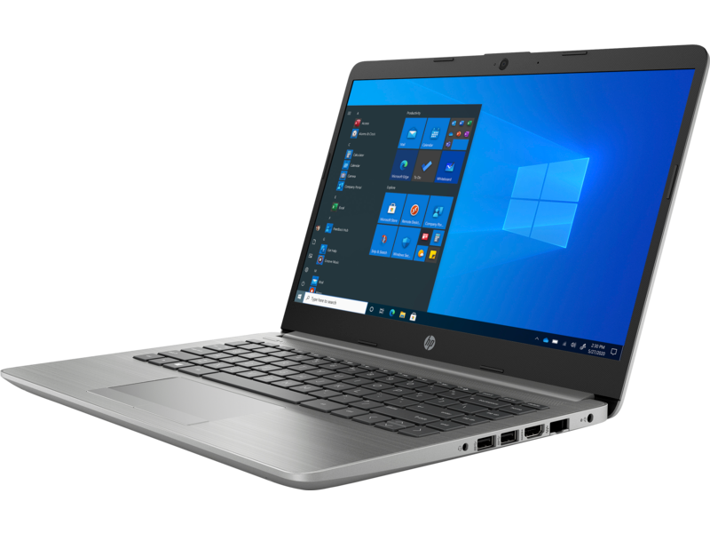
10. You will need a PC
You will need :
A PC or a desktop computer (with Linux or windows operating system).
A background in electronics and computer programming will be necessary.
A permanent internet connection whose name and password will be used in the operating program of the device.

Slide 17

2. CONNECT AND TEST THE COMPONENTS

Slide 18
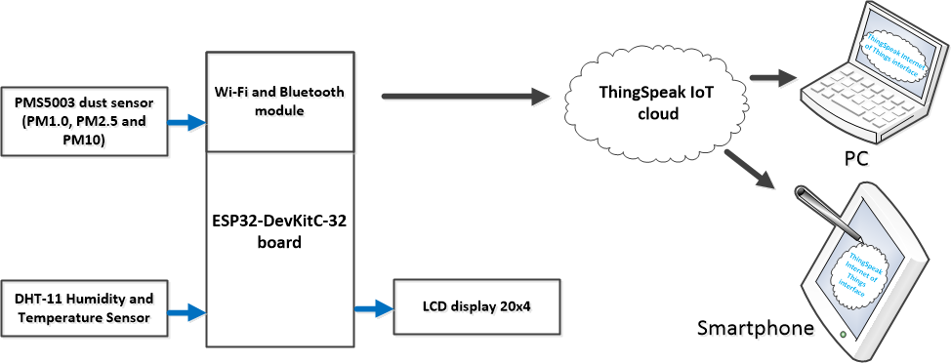
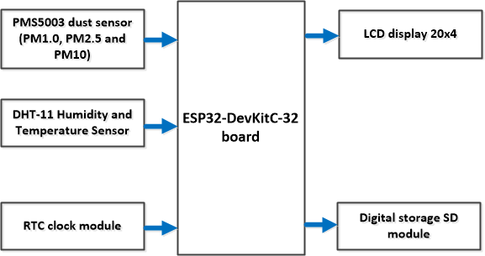
The block diagram
1
First part of the system to be realized during this workshop.
2
We are counting on you to carry out the second part of the system, once you return home!!!
Because you would already be equipped during the workshop (components, knowledge, etc.).
1
2

Slide 19
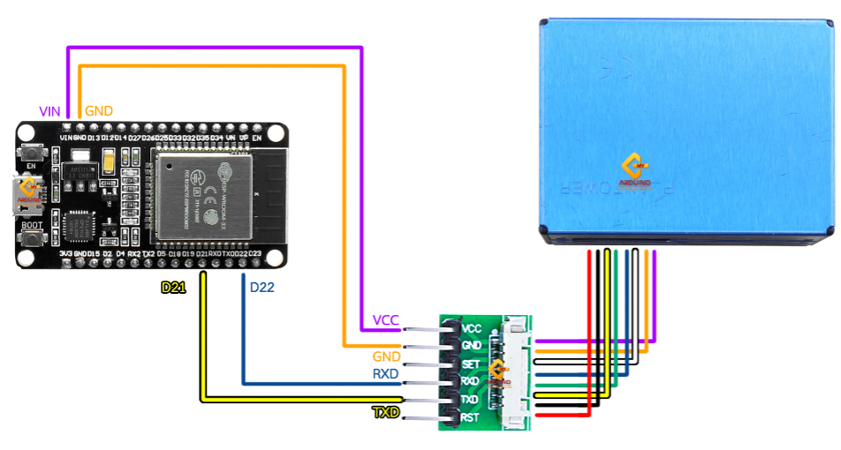
1. Connect the dust sensor PMS5003 with the ESP32 board
Standard connection pinout
PMS5003 | ESP32 board
RXD | D17 (TX2)
TXD | D16 (RX2)
GND | GND
5V | VIN

Slide 20
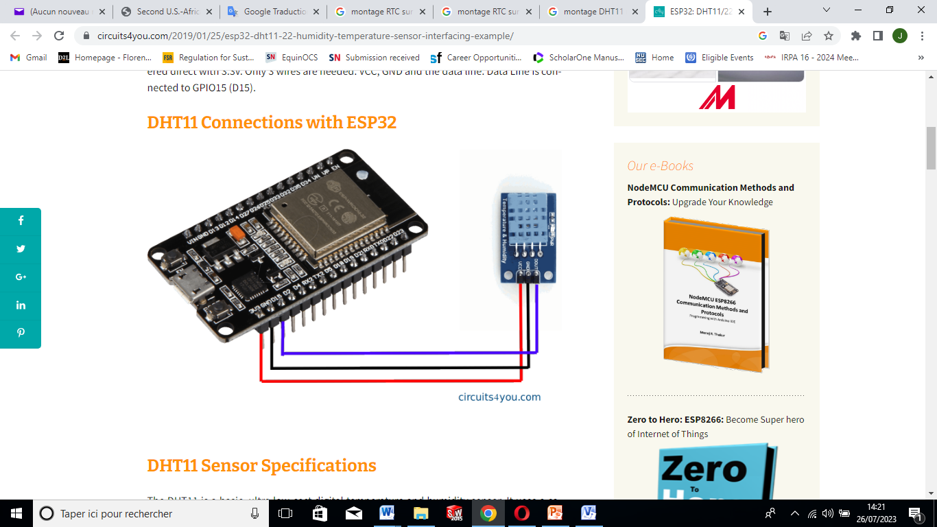
2. Connect the Temperature/Humidity sensor with the ESP32 board
Connection pinout
DHT11 | ESP32 board
SIGNAL (Out) | GPIO15 (D15)
GND | GND
5V | VIN

Slide 21
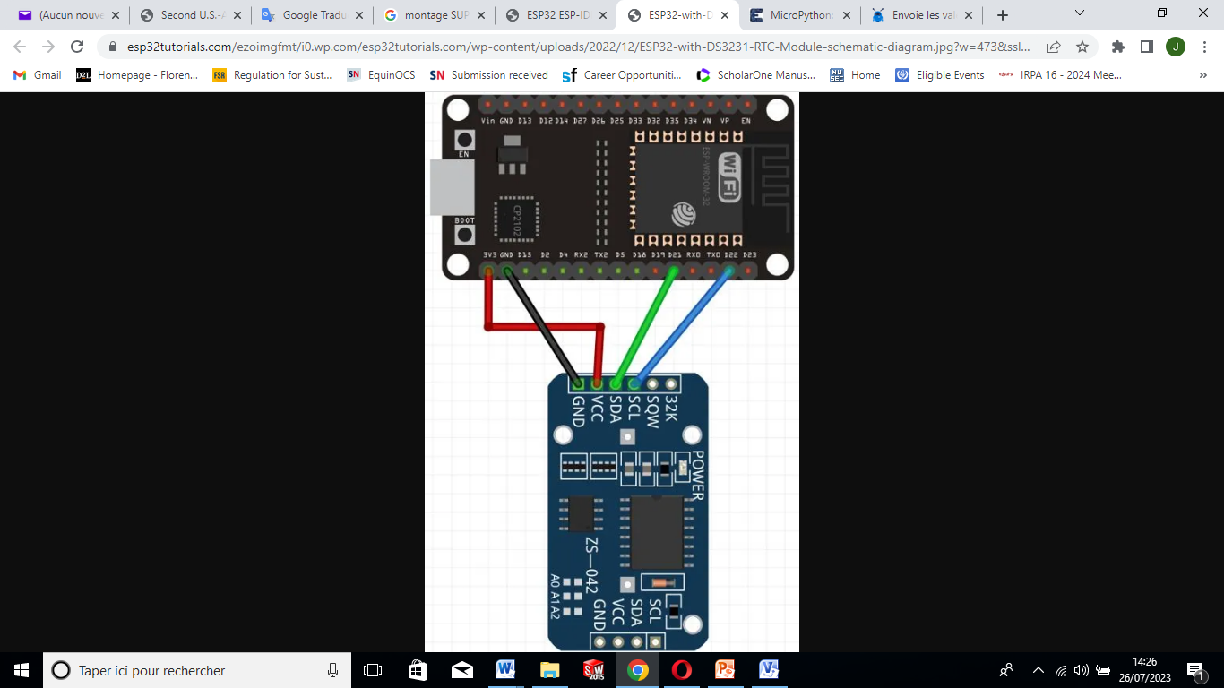
3. Connect the RTC module with the ESP32 board
DS3231 Module | ESP32
GND | GND
VCC | 3.3V
SDA | GPIO21 (I2C SDA)
SCL | GPIO22 (I2C SCL)

Slide 22
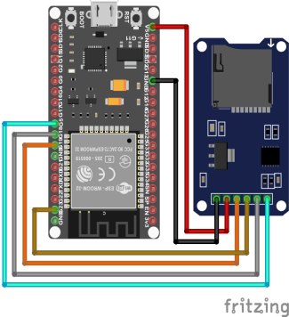
4. Connect the MicroSD support with the ESP32 board
SD Card Pin | EPS32
GND | GND
VCC | V5 or 3V3
MISO | 19
MOSI | 23
SCK | 18
CS | 5

Slide 23
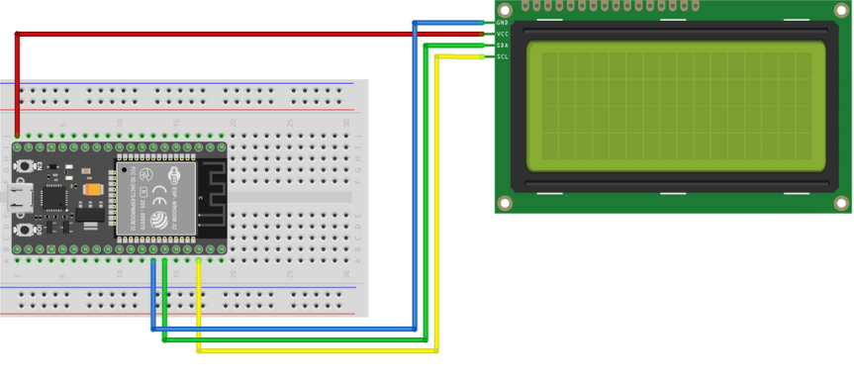
5. Connect the LCD I2C 20x4 screen with the ESP32 board
Connection pinout
LCD I2C 20x4 | ESP32 board
SDA | D21
SCL | D22
GND | GND
5V | VIN

Slide 24
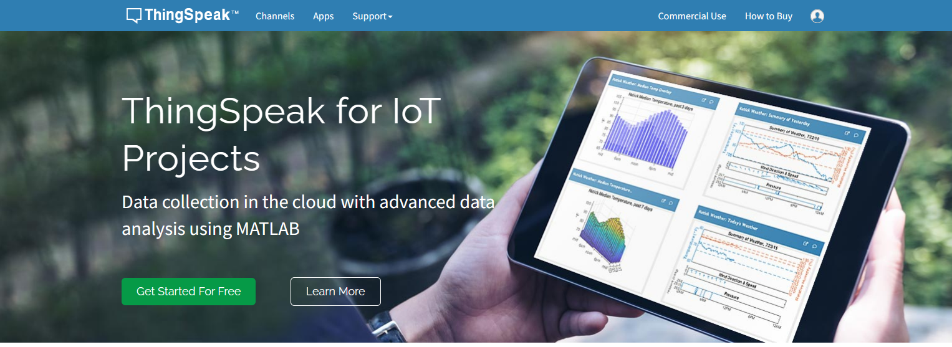
6. Connect the system to the Cloud plateform : ThingSpeak – Getting Started
Go to ThingSpeak (https://thingspeak.com/) and click the “Get Started For Free” button to create a new account.
This account is linked to a Mathworks account. So, if you already have a Mathworks account, then you should log in with that account.

Slide 25
10. The marketplace
Item | Unit price (€)
PMS5003 sensor | 33,69
DHT-11 Sensor | 3,05
SD card | 3,81
RTC module | 3,81
LCD 20x4 | 6,10
SD support | 3,81
ESP32 | 15,24
Jumper | 3,05
Box | 0,76
Test plate | 3,80
Power supply adapter | 5
The device can be built with components at a total cost below €100.

Slide 26
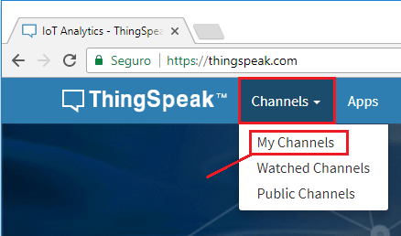
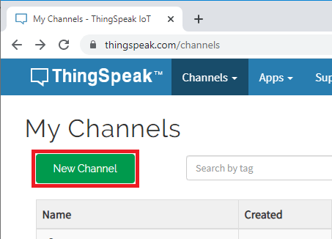
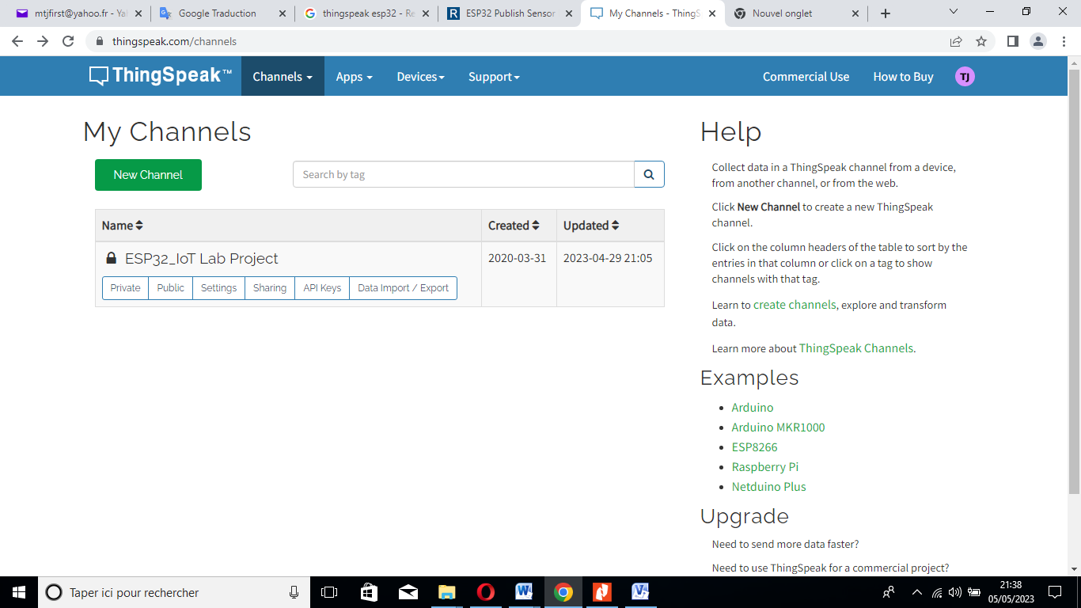
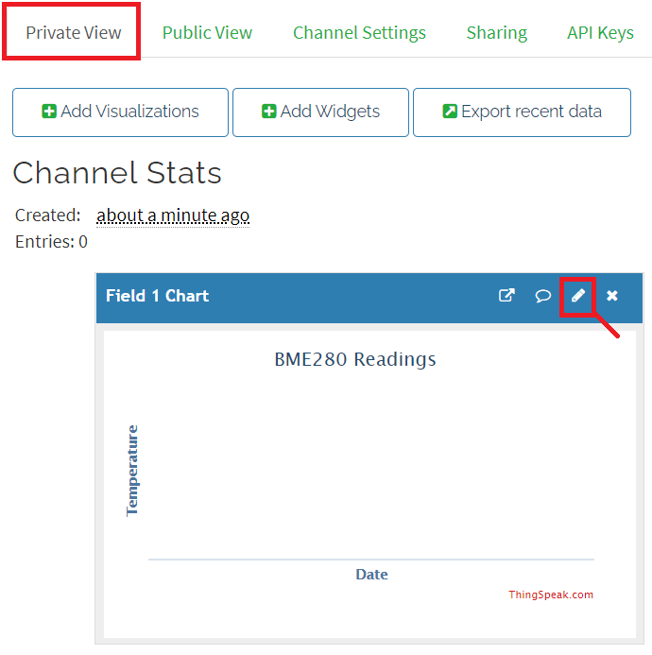
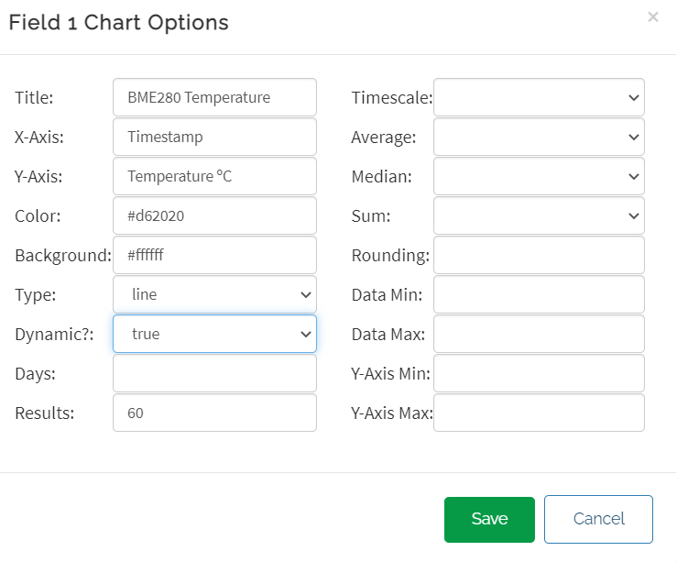
6. Connect the system to the cloud plateform : ThingSpeak – Getting Started
1, Create your channels
2.Type the name of the channel and add a description

Slide 27
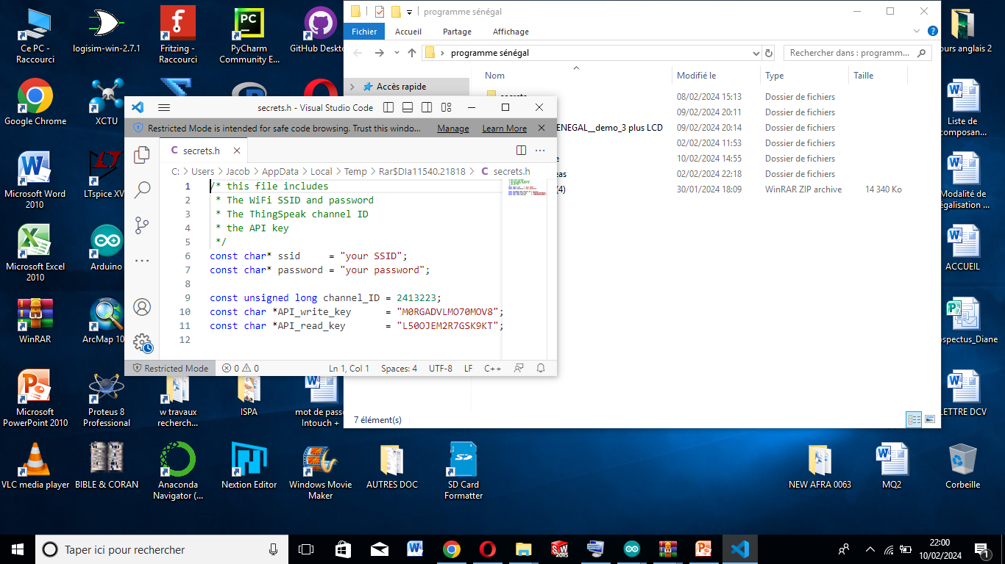
6. Connect the system to the cloud plateform : ThingSpeak – Getting Started
3. Generate the API keys which will be customized in the working code

Slide 28

3. CODING AND PROGRAMMING

Slide 29
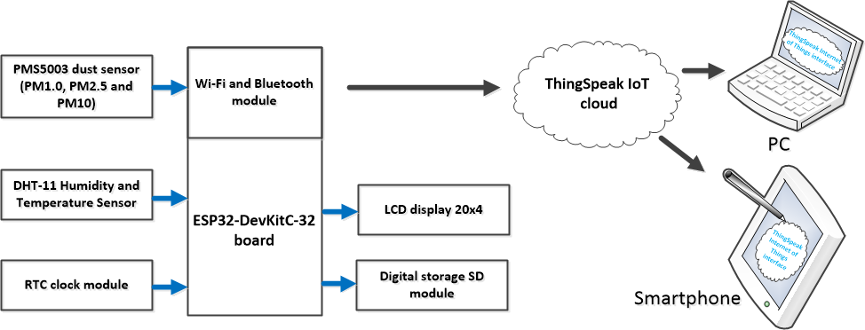
The block diagram
The device measures following parameters: PM1, PM2.5, PM10, Temperature and Humidity.
The data should be saved in the microSD card and sent to the Thingspeak Cloud. They must also be displayed in real time on the LCD screen.

Slide 30
7. Programming the system on IDE Arduino
Write the operating program for each sensor and electronic component to be used (sensors: PMS5003 and DHT11, components: LCD, RTC, SD);
Individually program and test the operation of sensors and components;
Create your account on the Thingspeak platform, customize it and copy the API key;
Write and test the data transmission program (Wi-Fi and Thingspeak) to the Cloud platform by inserting in this program: the API keys, the channel number, the name and password of your personal WiFi;
Gradually merge the programs to obtain a final program of the device;
Compile the programs at each stage and correct errors if they occur;
Assemble the device and upload the final program;
Power the device and check its operation on LCD, Serial monitor of IDE Arduino and the Thingspeak platform.

Slide 31
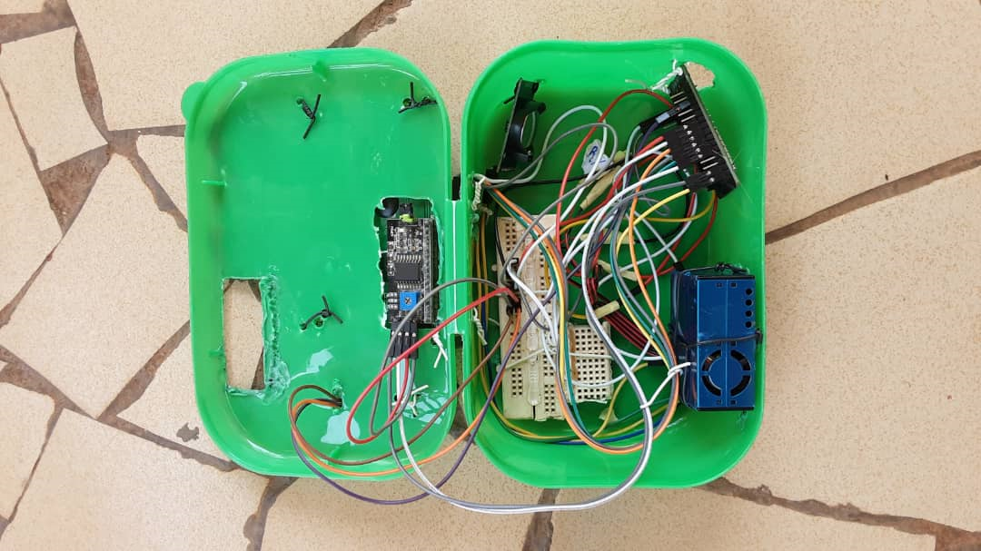
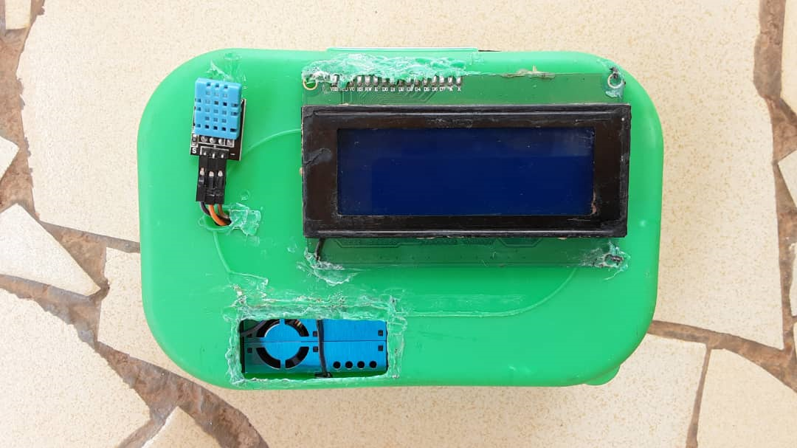
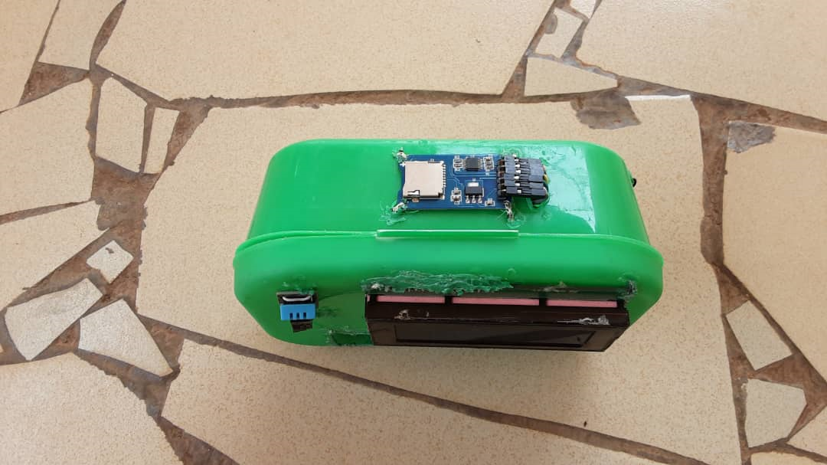
7. The assembling of the system

Slide 32
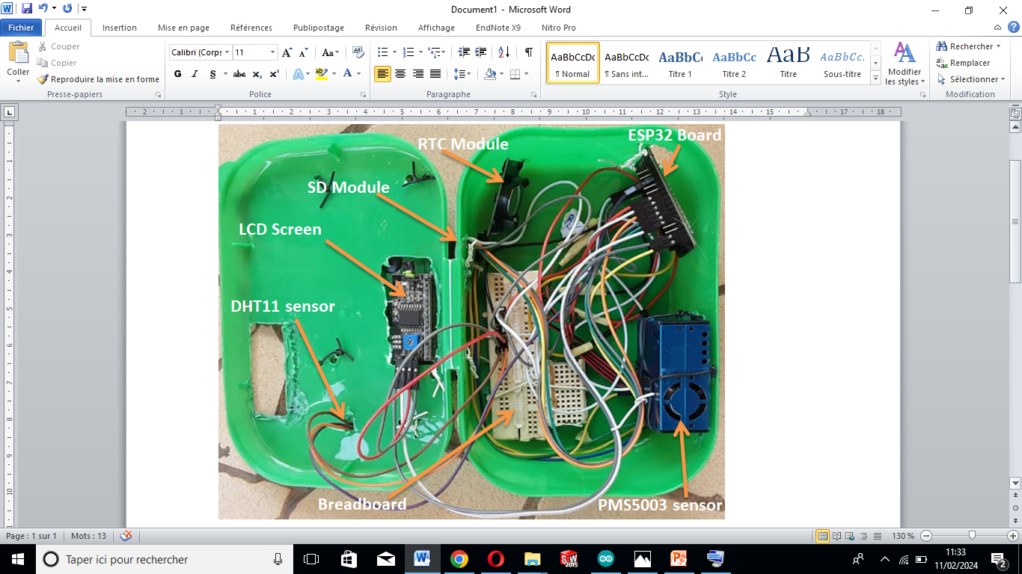
7. The assembling of the system

Slide 33
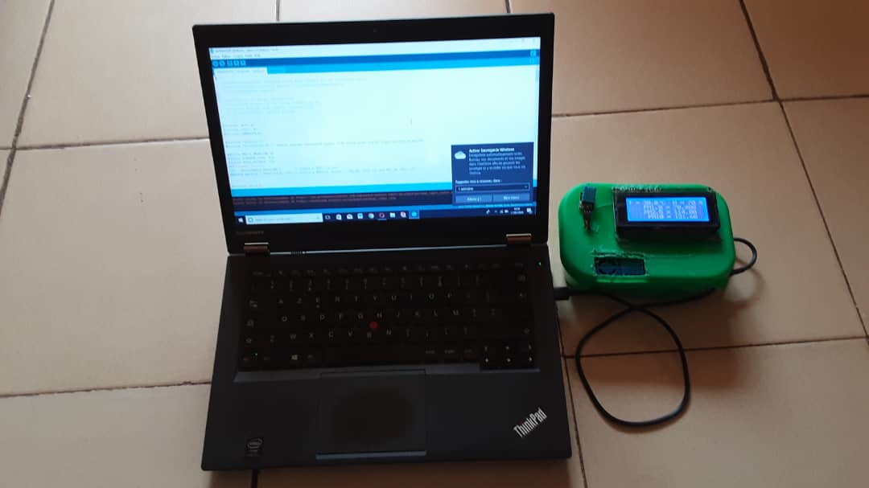
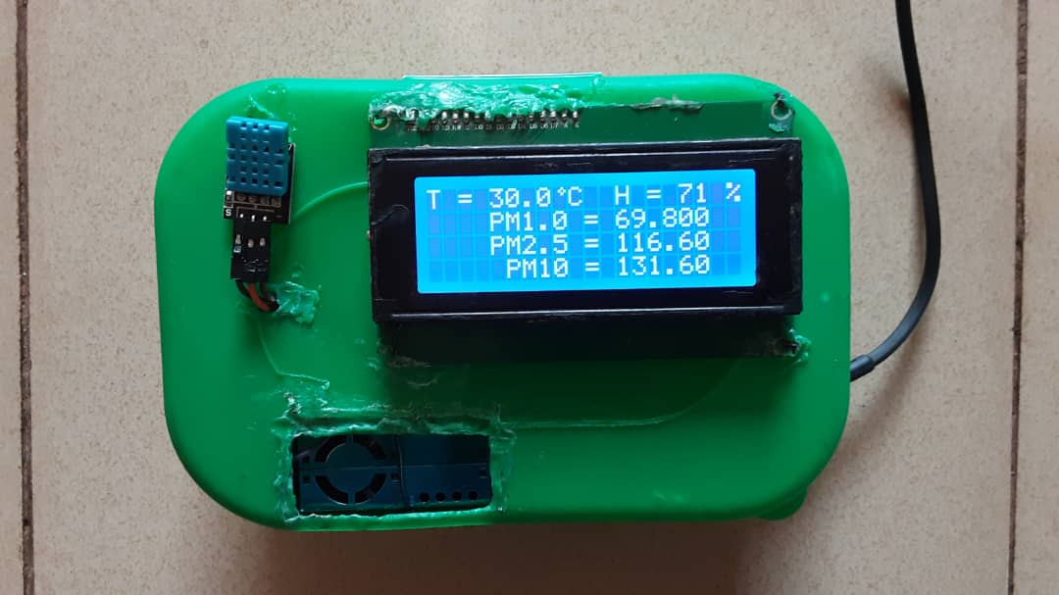
8. Testing of the system
Notes:
to this end, we have obtained results

Slide 34
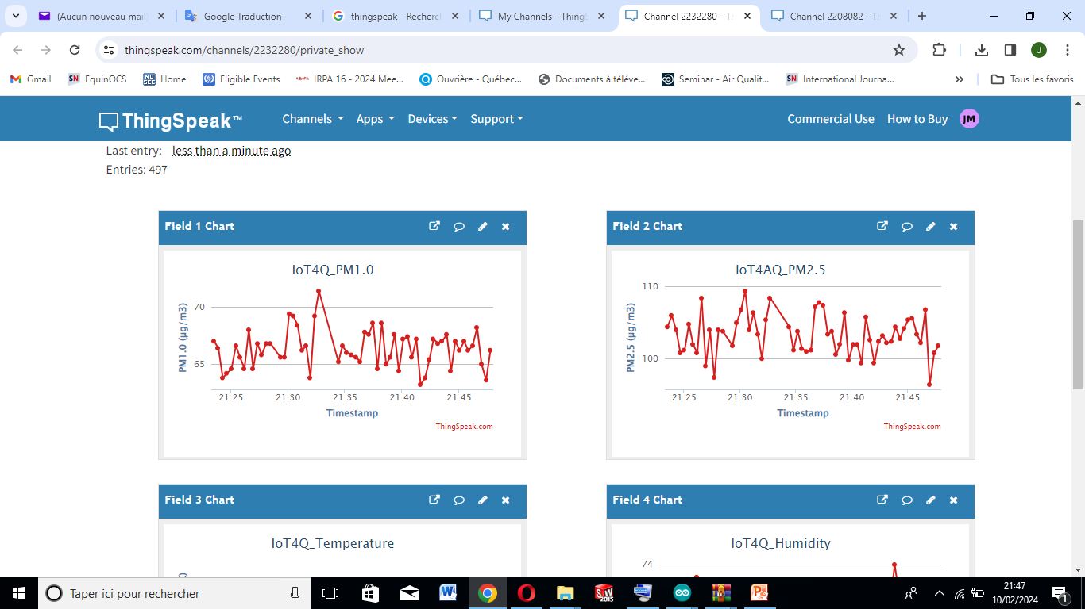
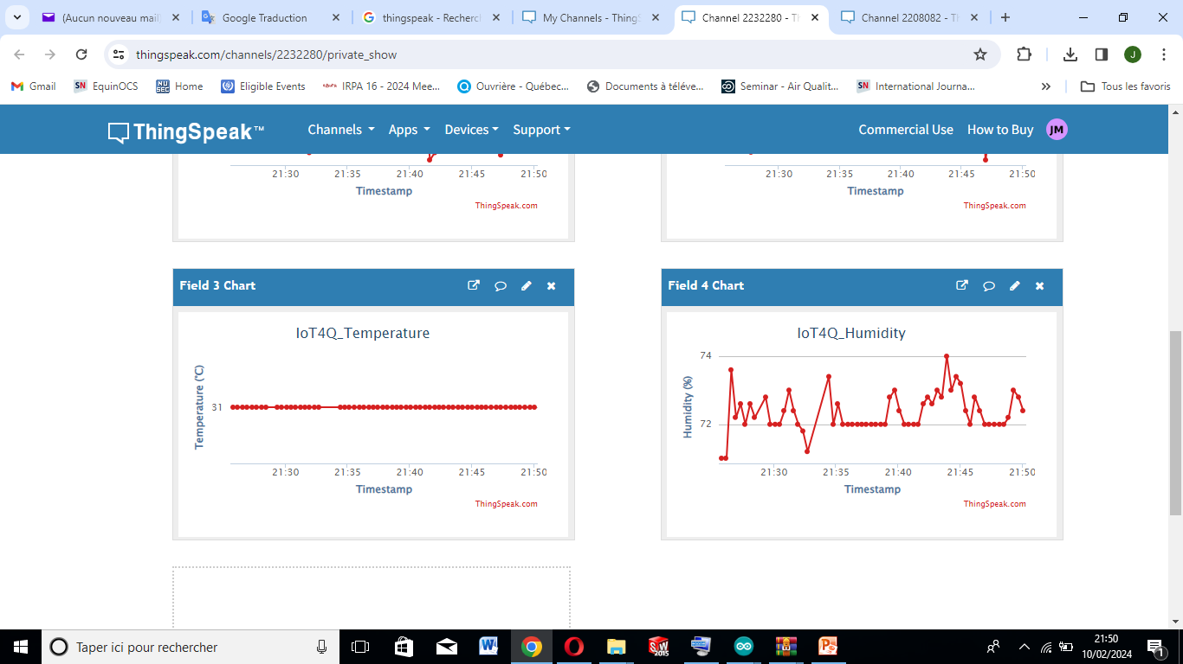
9. Real-time data evolution on the Thingspeak platform
PM1.0 (µg/m³)
PM2.5 (µg/m³)
Temperature (°C)
Relative Humidity (%)
Notes:
to this end, we have obtained results

Slide 35
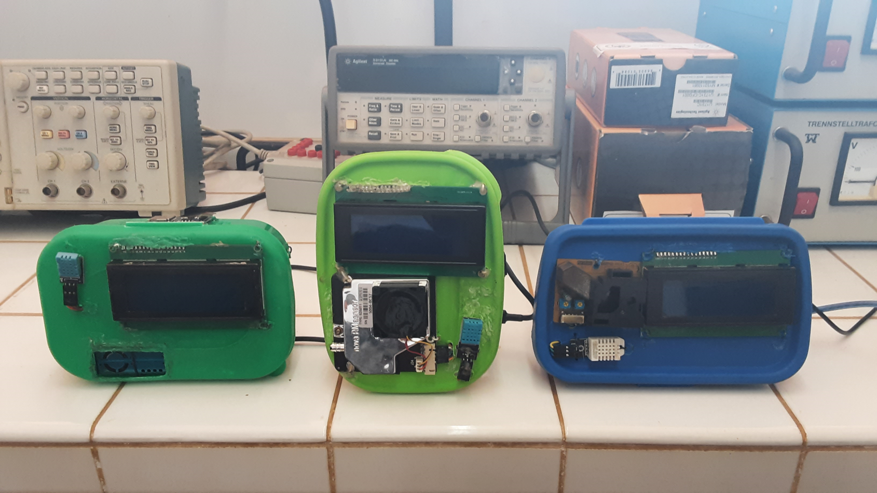
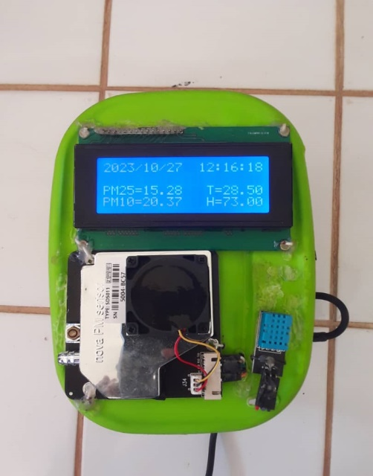
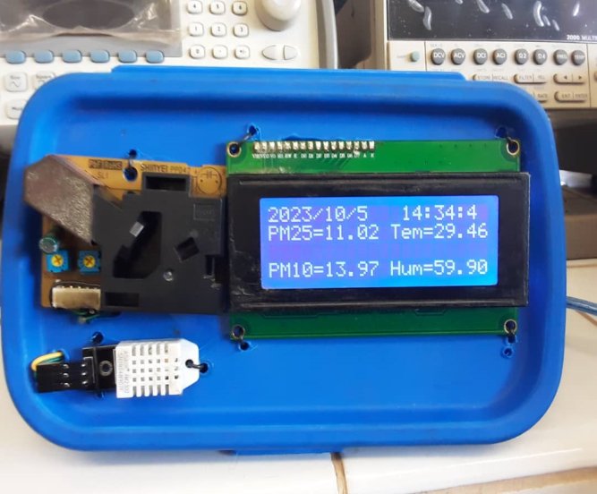
9. Systems realized during the IoT4AQ project, 2023-2024
IoT system based on
ESP32/Wi-Fi/PMS5003
IoT system based on
ESP32/Wi-Fi/SDS011 nova PM
IoT system based on
Arduino Uno /SHINYEI PPD42NS/GSM
Notes:
to this end, we have obtained results

Slide 36
If you find any difficulty, at any step, please feel free to contact us! Dr. J. Taamté (mtjfirst@yahoo.fr) Dr. Uli Raich (uli.raich@gmail.com) Dr. B. Tchanche (bertrand.tchanche@uadb.edu.sn)

